Slide 1
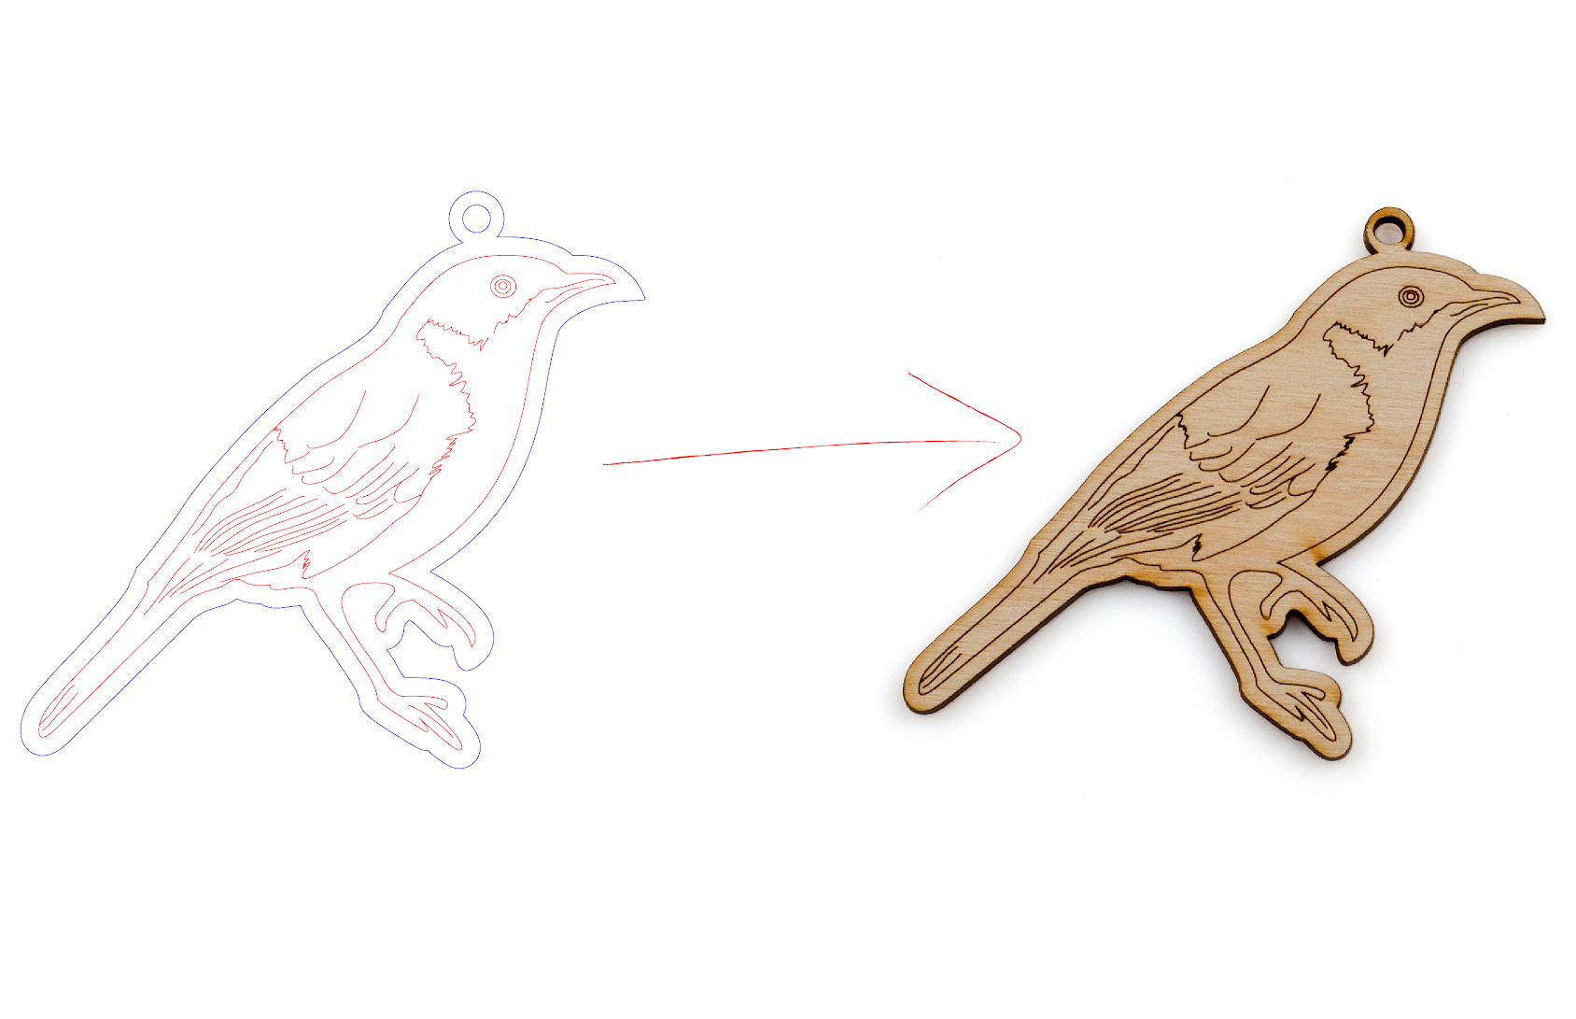
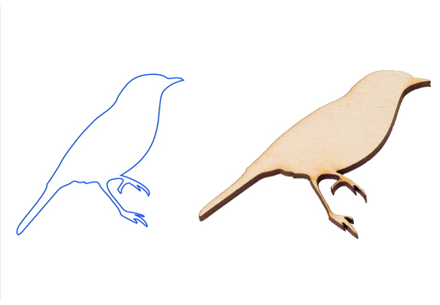
Vector Cut Vector Etch
Image Source: http://www.ponoko.com/starter-kits/inkscape

Slide 2
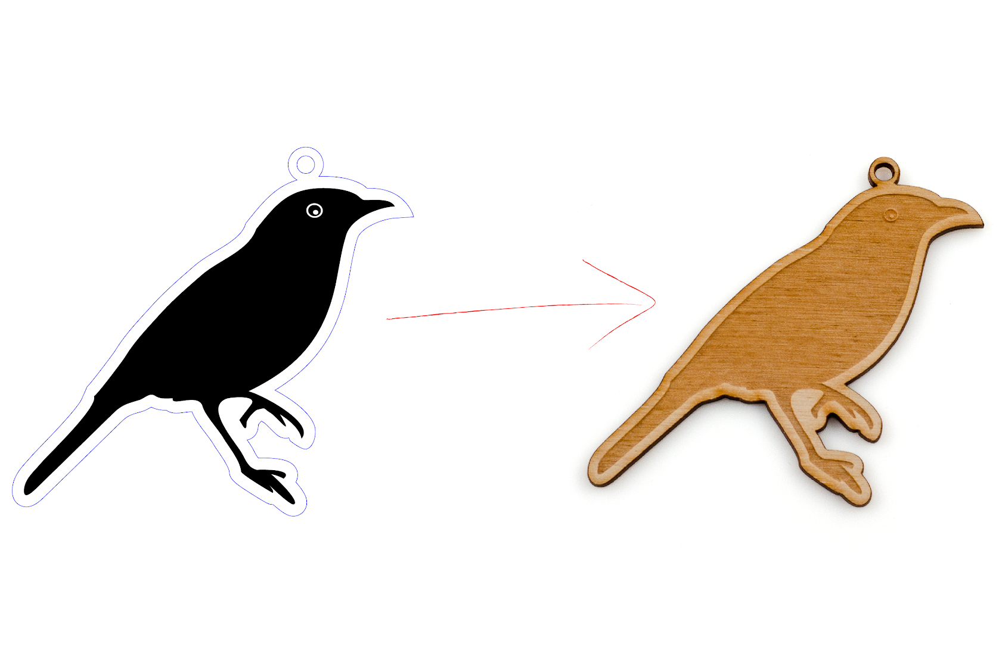
Vector Engrave

Slide 3
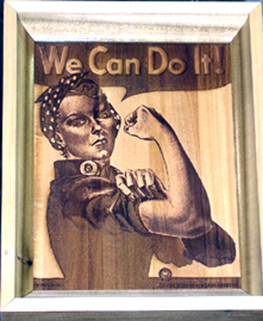
Raster Engrave
-May have to convert image to Black and White
-Resource: http://support.ponoko.com/entries/491242-How-to-Improve-your-Raster-Fill-Engraving-results
Img Source http://www.cpp.edu/~clhoke1/laserprimer.html

Slide 4
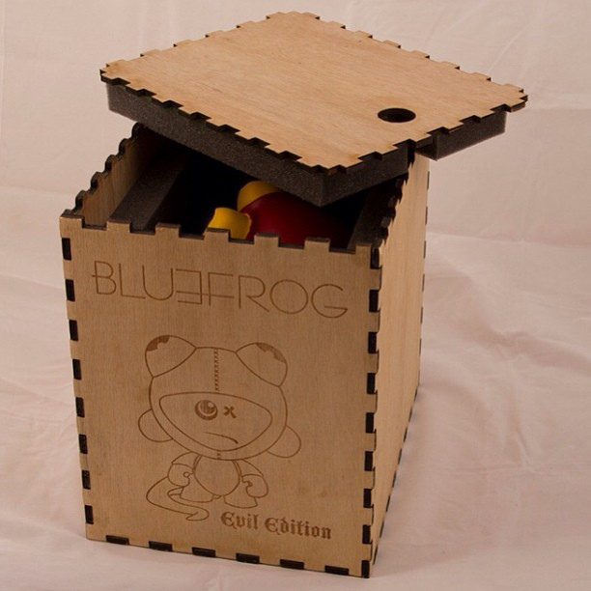
What else can it do?
Look for scripts that can automate the design of the box
http://blog.ponoko.com/2013/02/11/flat-pack-laser-cutting/

Slide 5
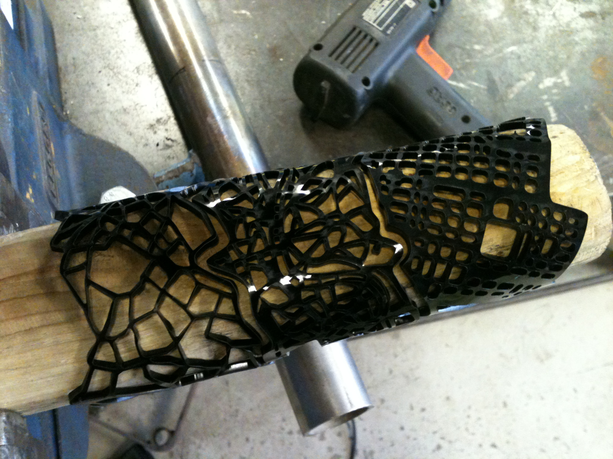
Heat Bend Acrylic
Heat Guns available in
Gregory’s Lab
Tutorial on Heat Bent Box here.
http://marinsina.blog.com/2012/08/08/heating-and-bending-acrylic/

